Slide 1




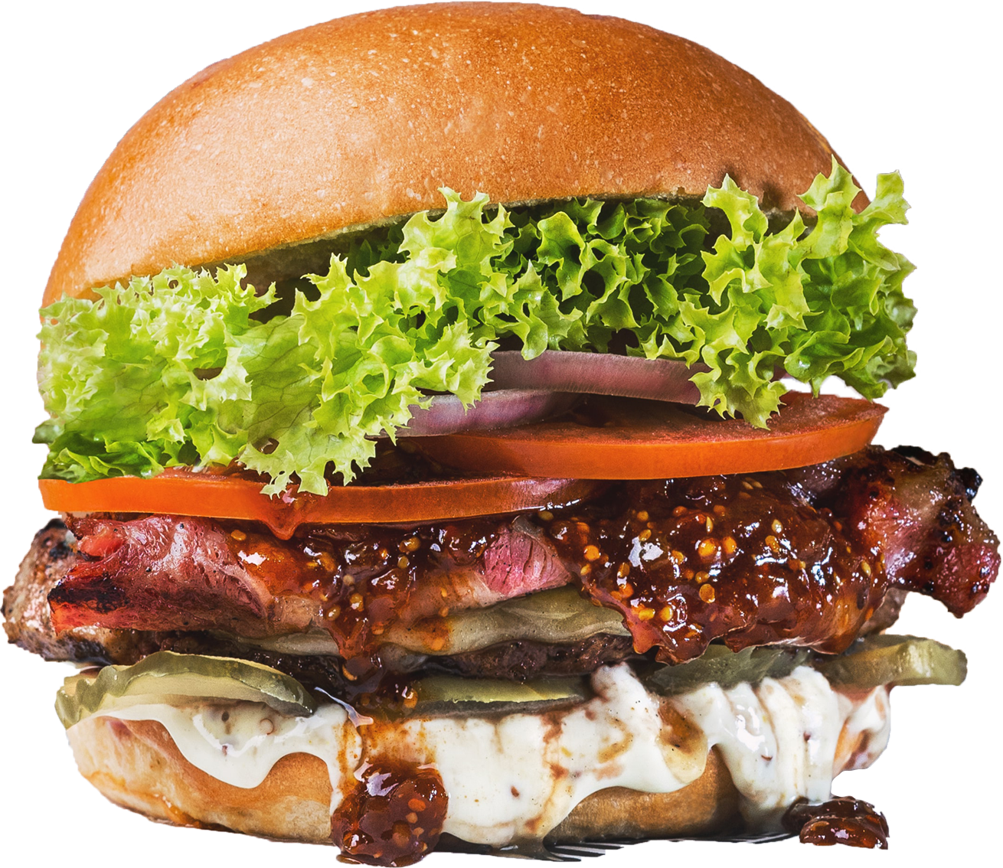



NEO4FOOD
DELIVERY
LARGE-SCALE AND MULTISTRUCTURE DATABASE
GABRIELE MARINO
MATTEO PASQUALETTI
FRANCESCO DE VITA

Slide 2
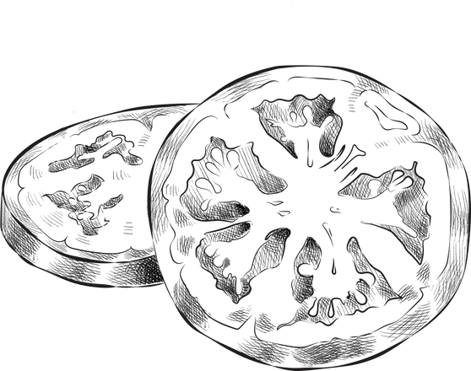




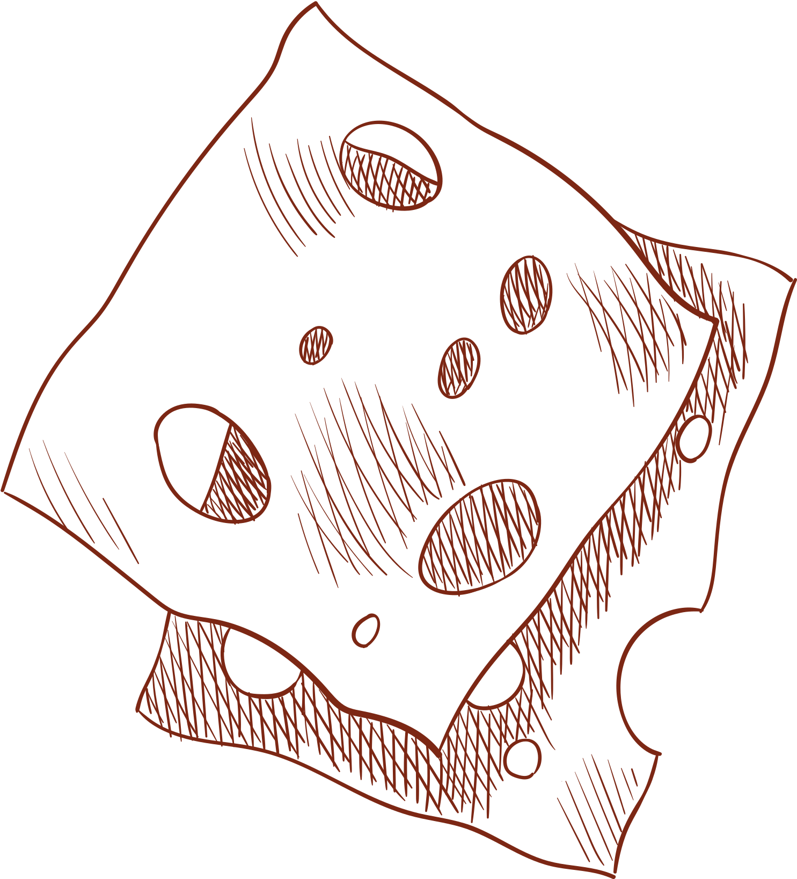

The Idea
Neo4Food is a service website where people can find restaurants and request them for food deliveries. Users can also use the built-in social-network system to get recommendations based on following people and rated restaurants.
The application is also meant to be used by restaurants themselves to expand their distribution chain.

Slide 3





Functional Requirements
Unregistered Users
Registered Users
Restaurants
Administrartor
Login
Sign Up
Find Restaurant
Modify Personal Data
Find Restaurant
Filter Restaurant
Place Order
Confirm Order
View Past Orders
Follow Users
Rate Restaurants
View Restaurants Reviews
Login
View Pending Orders
View Past Orders
Confirm Order
Modify Dishes
View Ratings
Analytics
Access with dedicate Token
Analytics
Update Ratings
Update Prices

Slide 4




Non-Functional Requirements
The application must be available 24/7
The application must respond to any user input within milliseconds
The application must satisfy all requests even at high loads
The application must be user-friendly with high usability

Slide 5


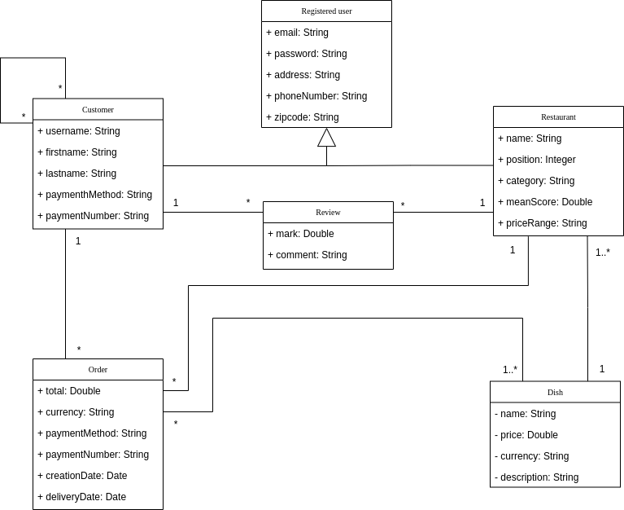
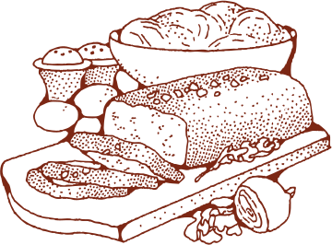
UML

Slide 6

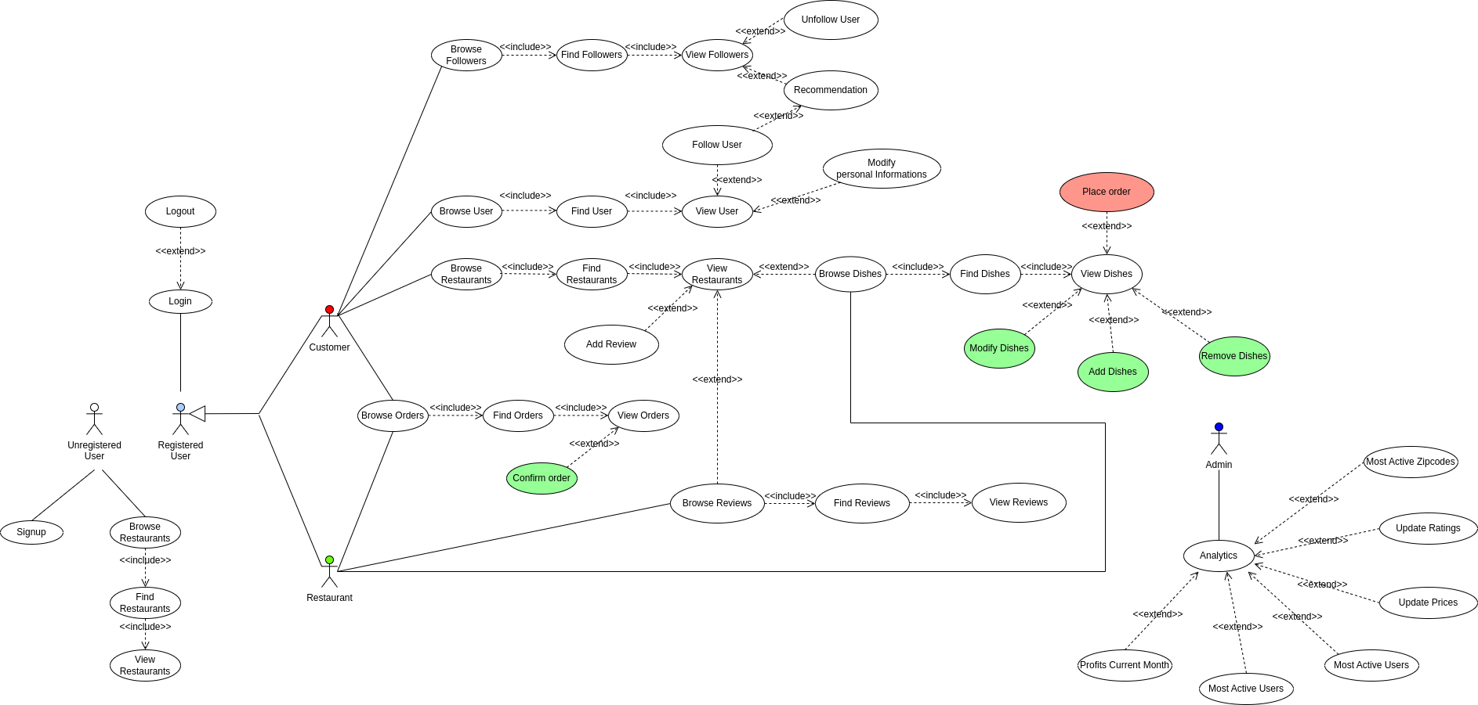


Use Case Diagram

Slide 7








C
A
CAP Theorem
We want to guarantee High-Availability and Partition Protection, so we placed our application in the AP area of the CAP Theorem.
P

Slide 8





Replicas
We set MongoDB with 3 replicas.
Write Concern
In order to guarantee a low-latency response and high availability, we chosed that any write operation may be considered completed when one write is complete. Our global write concern is set as W1.
Read Concern
We decided to set the read preference on nearest replica, because we wanted to guarantee low-latency, as we considered Neo4Food more oriented on reads than on writes.

Slide 9
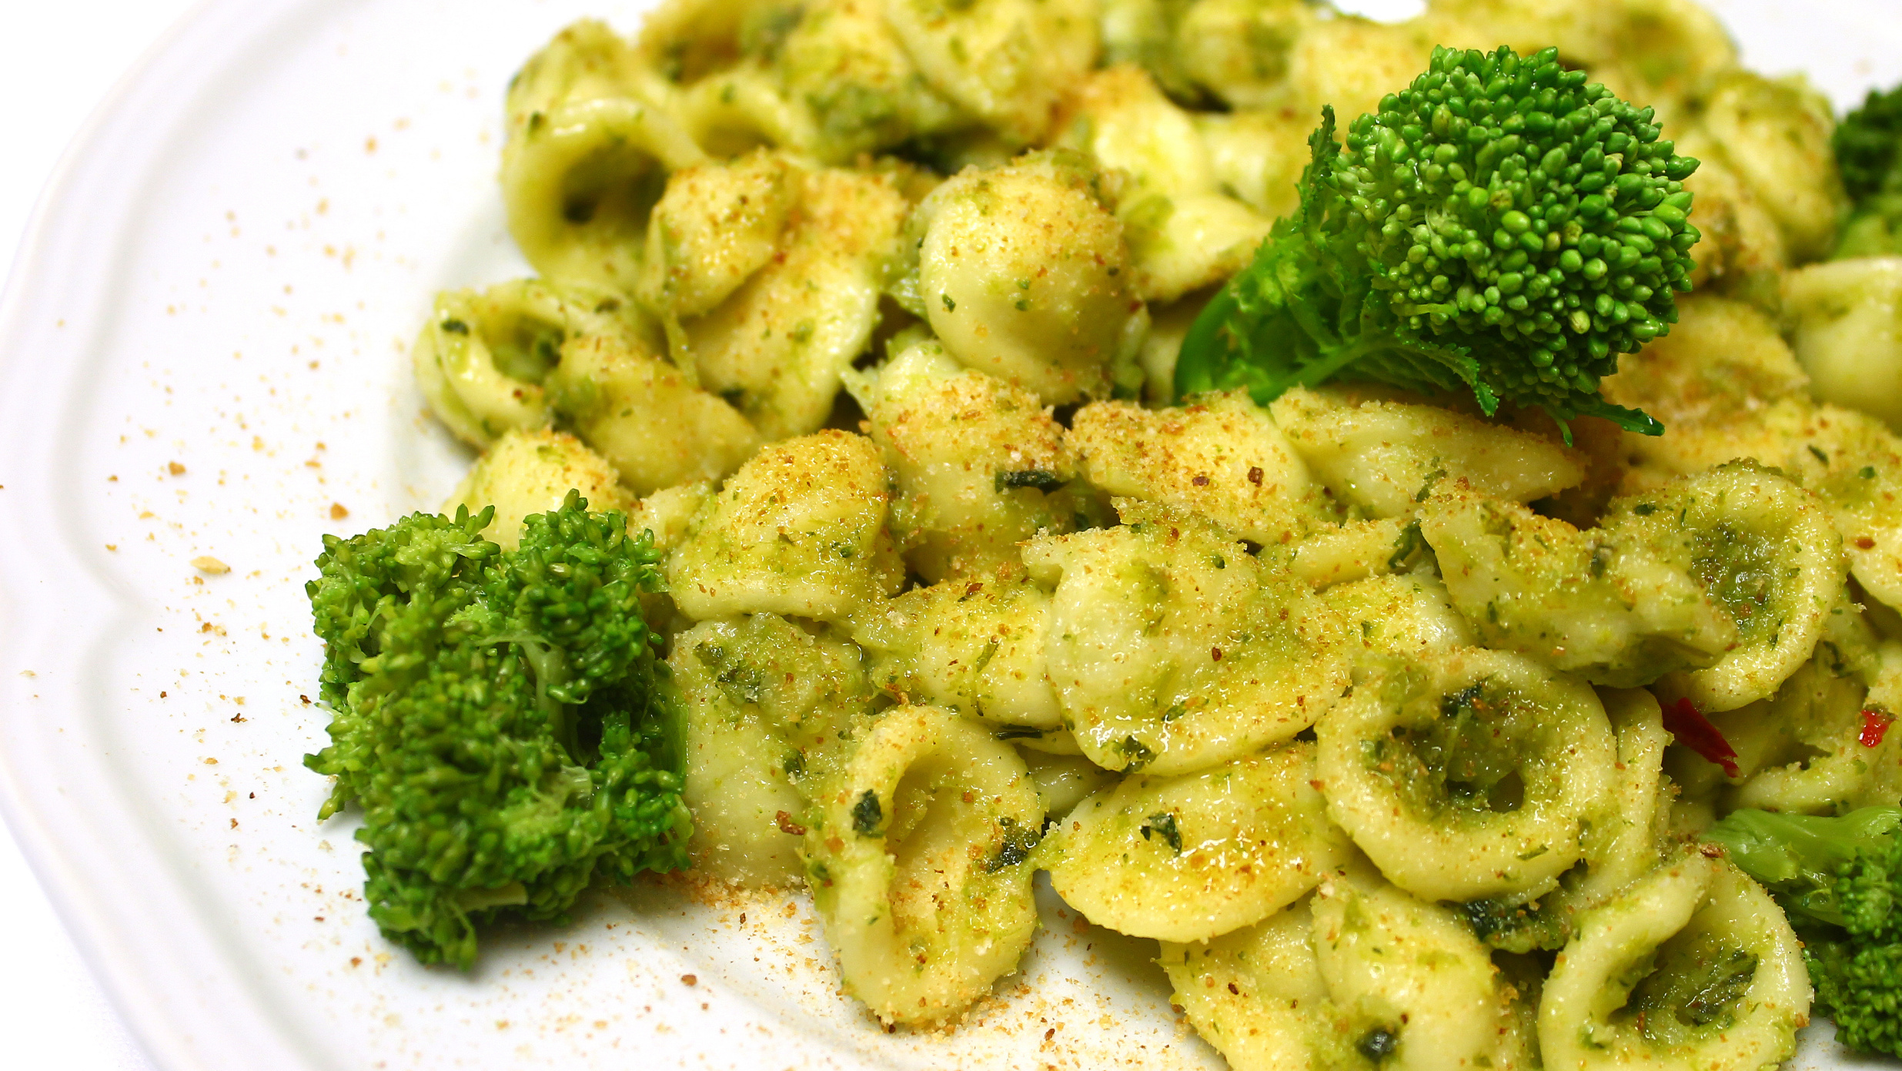

Dataset
Description

Slide 10

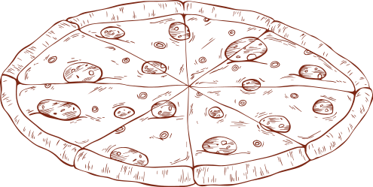
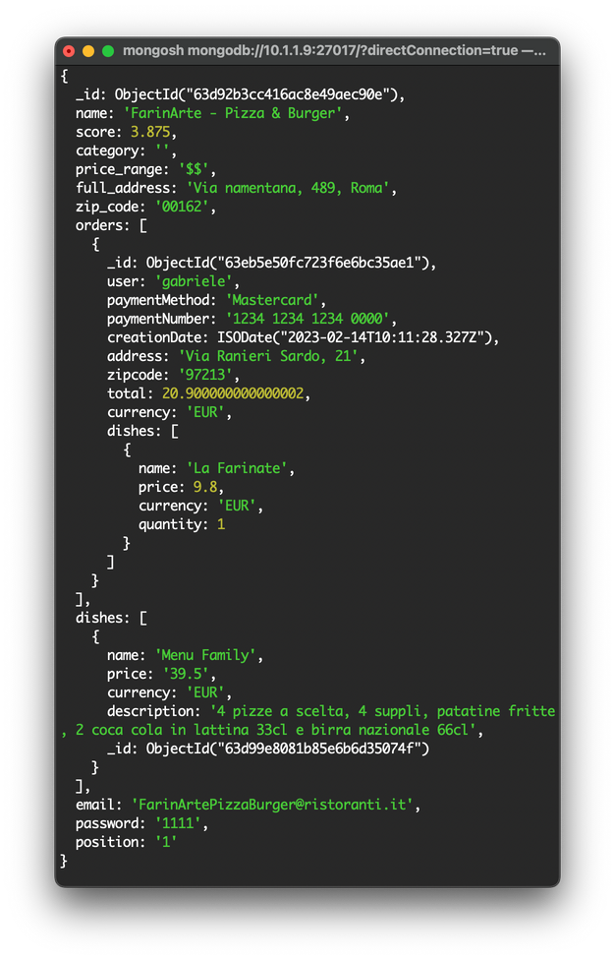
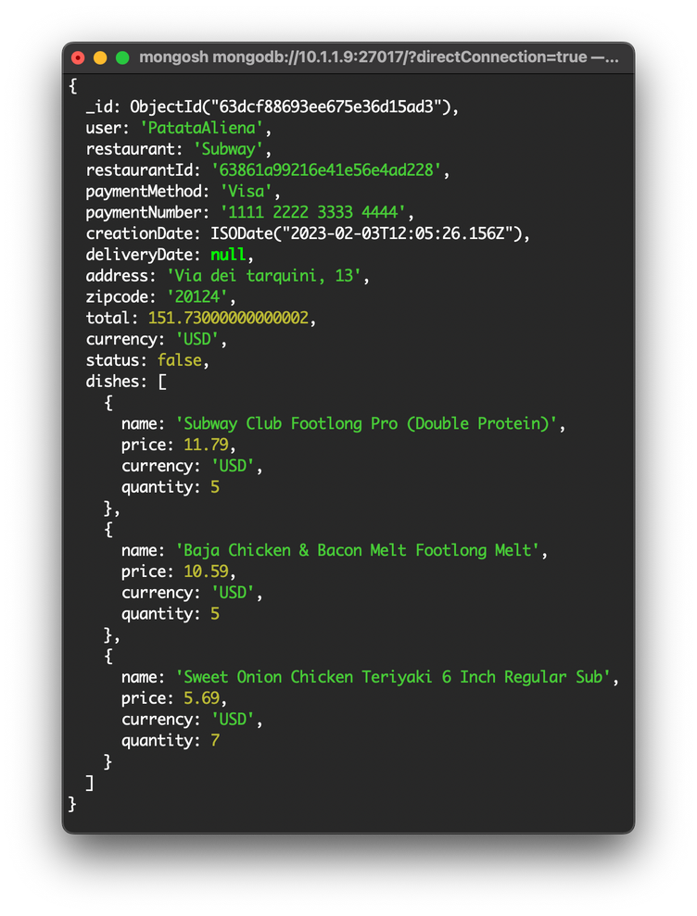
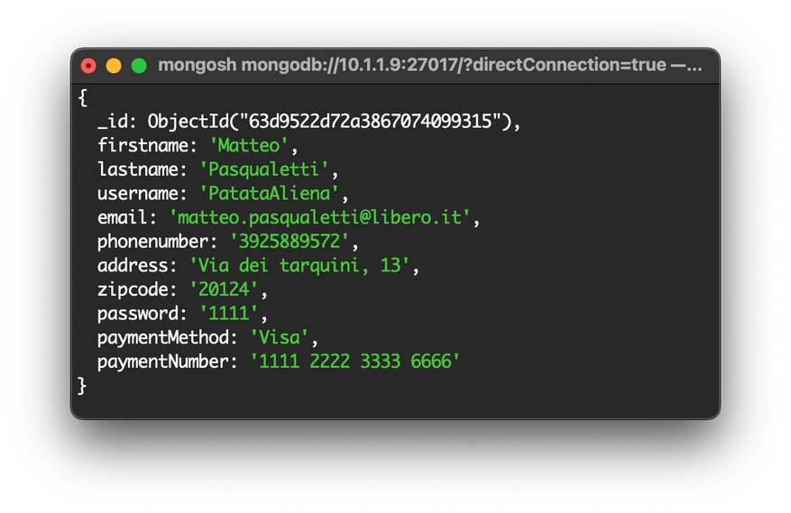

Design For MongoDB
Restaurant
Order
User

Slide 11

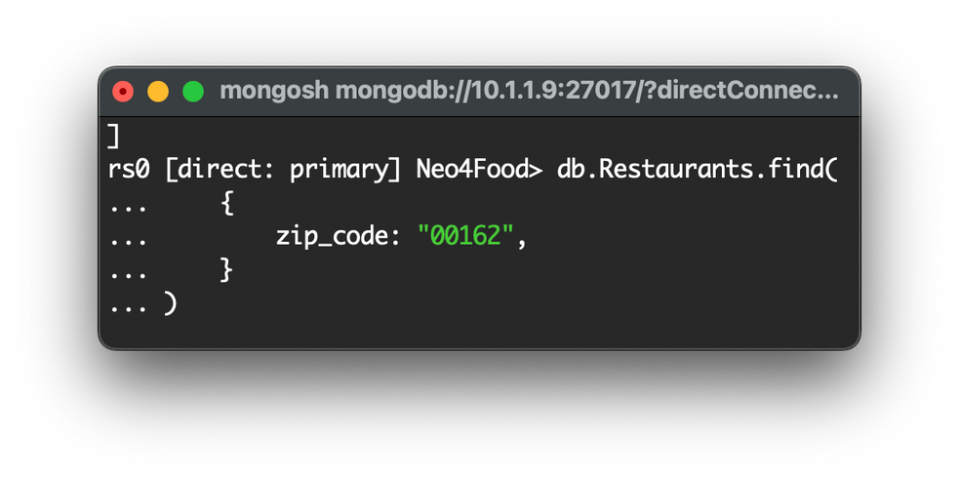

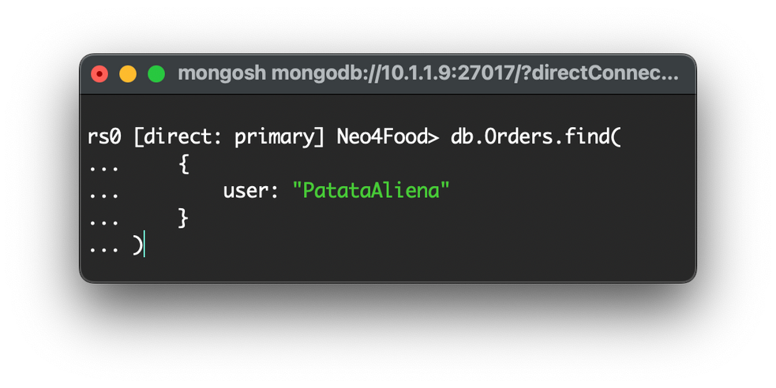
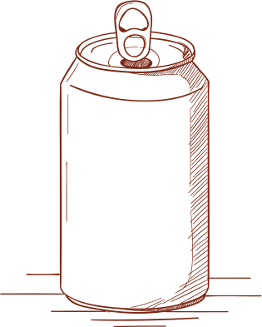
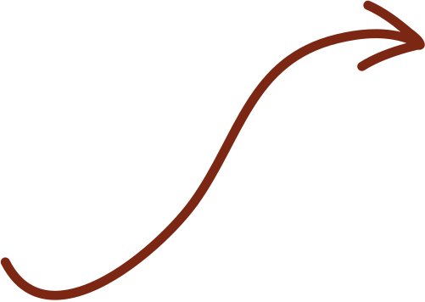

Most Used Queries
Index Analysys | Execution Time | Keys Examined | Docs Examined
_id | 79 | 38581 | 38581
zip_code | 0 | 7 | 7
Index Analysys | Execution Time | Keys Examined | Docs Examined
_id | 739 | 602701 | 602701
user | 2 | 19 | 19

Slide 12

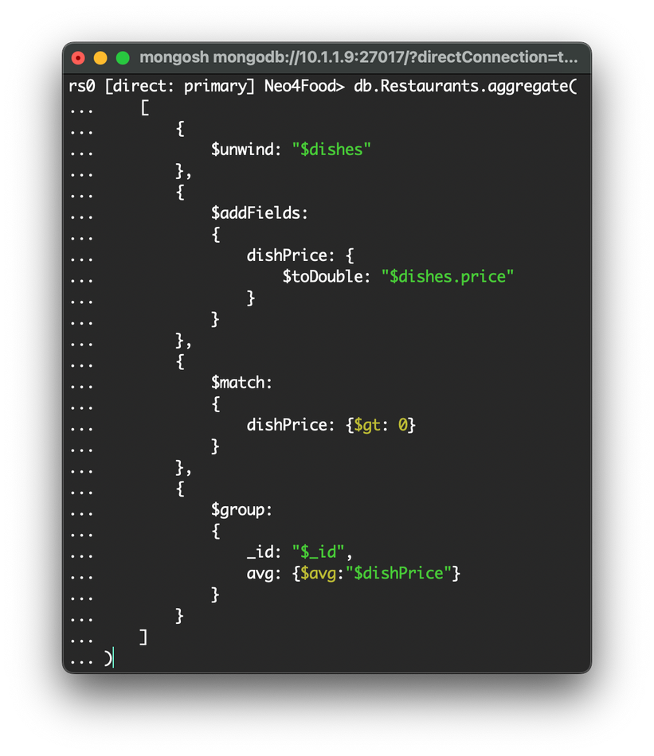
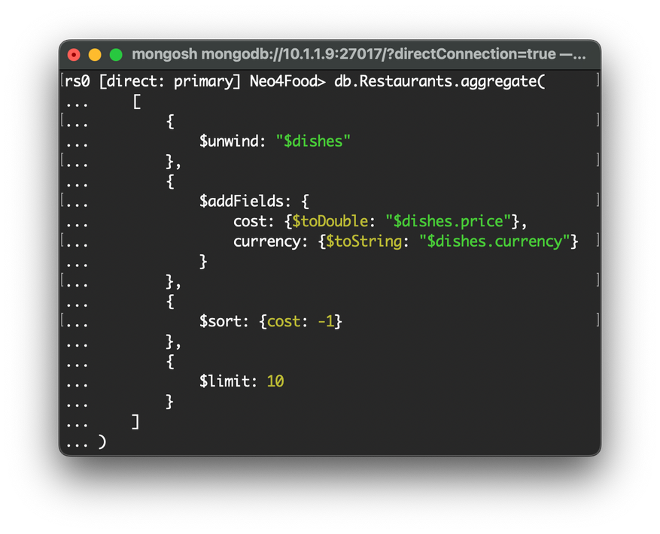
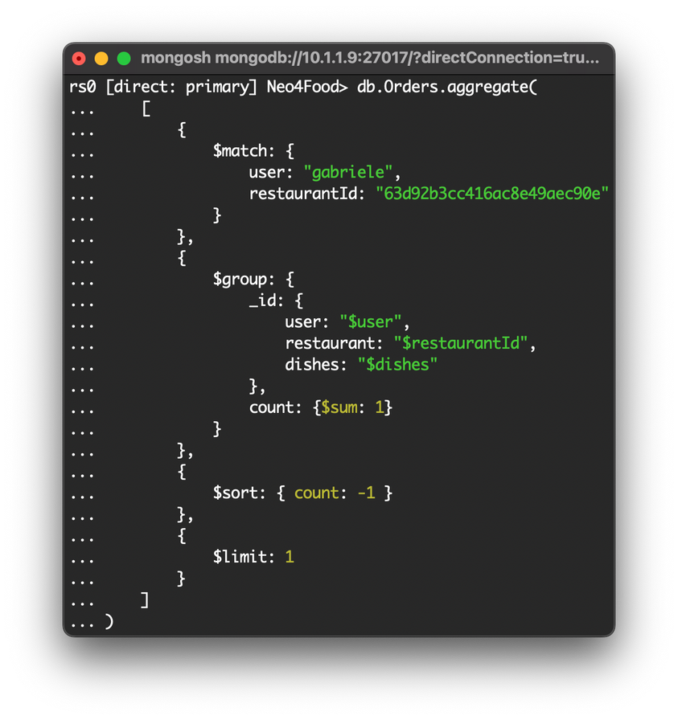

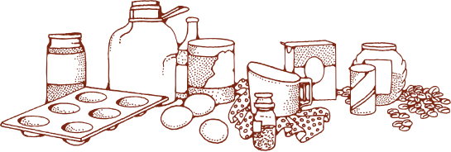
MongoDB Aggregations
Average Price
Most Expensive Dishes
The Usual

Slide 13
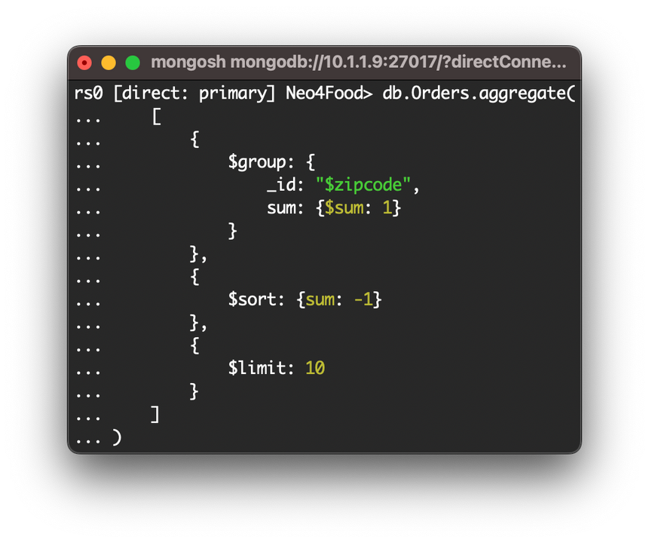
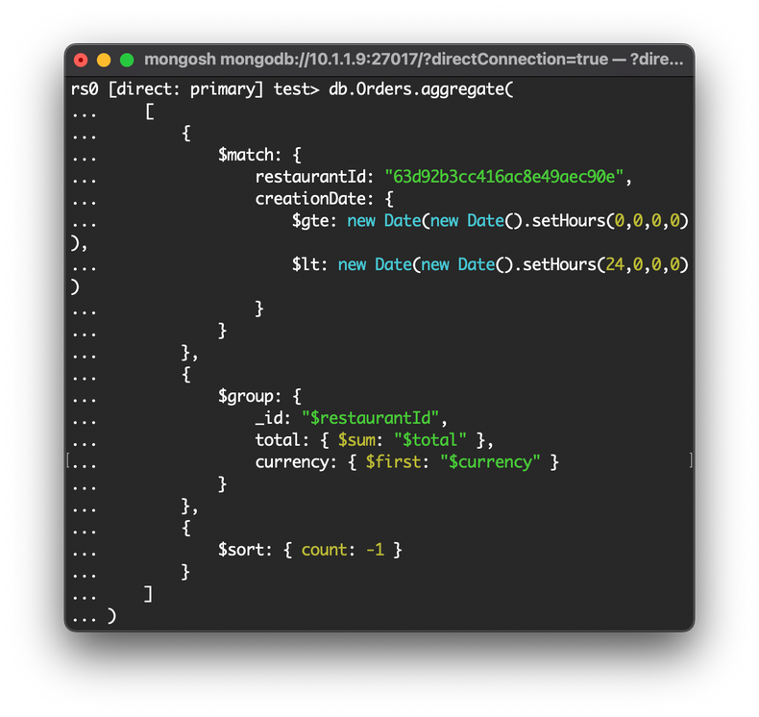
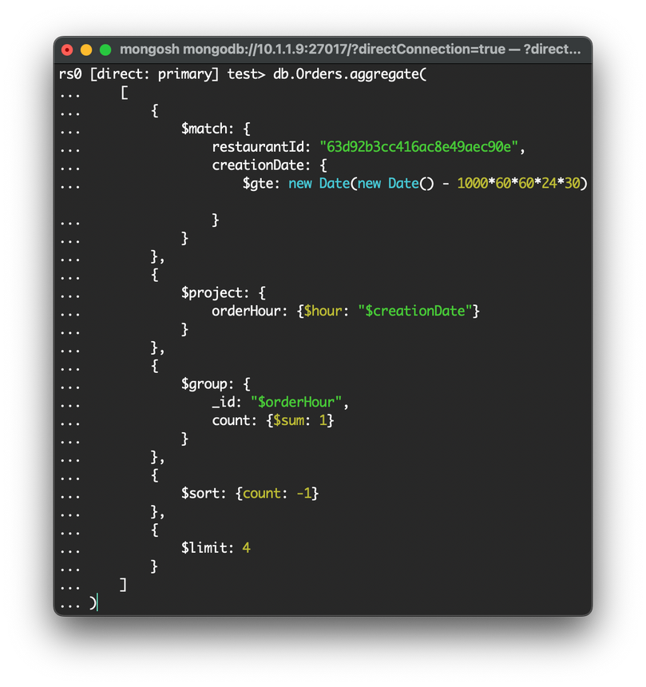
MongoDB Aggregations
Top 10 Zipcodes
Month's Revenue
Most Busy Hours

Slide 14
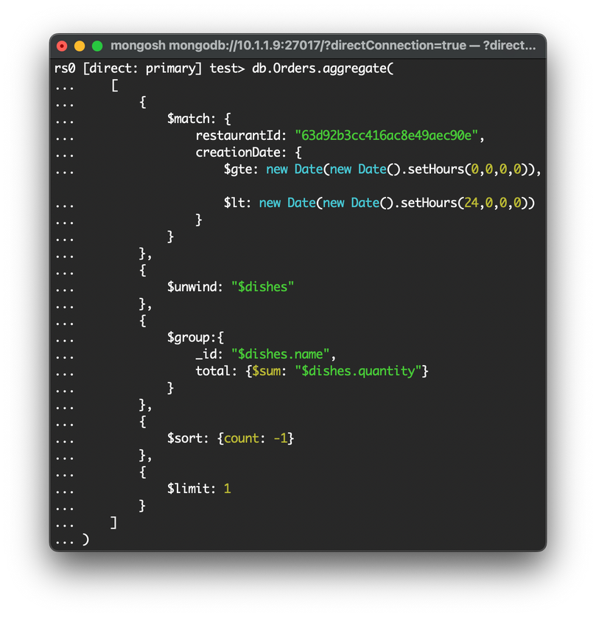
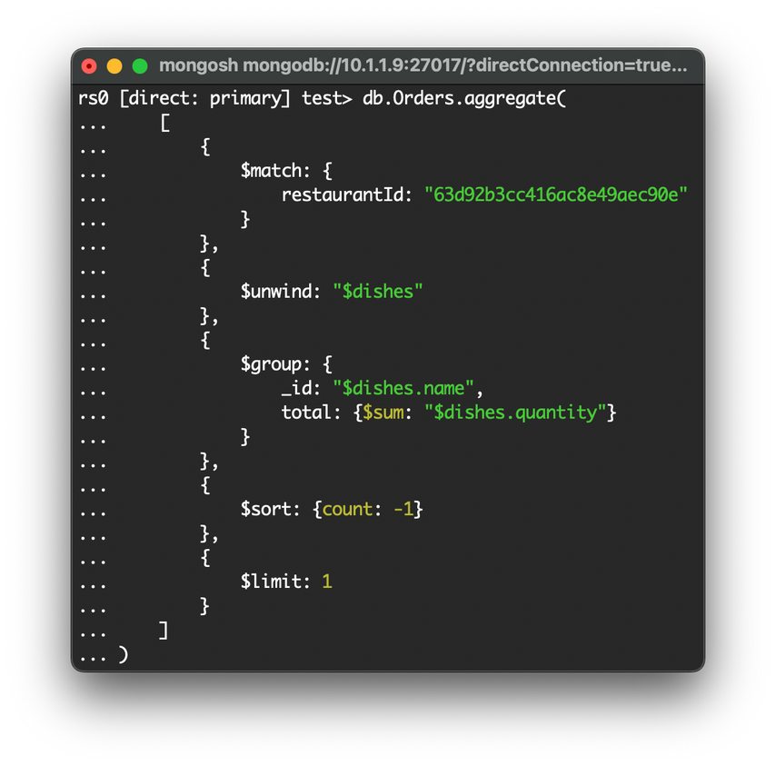
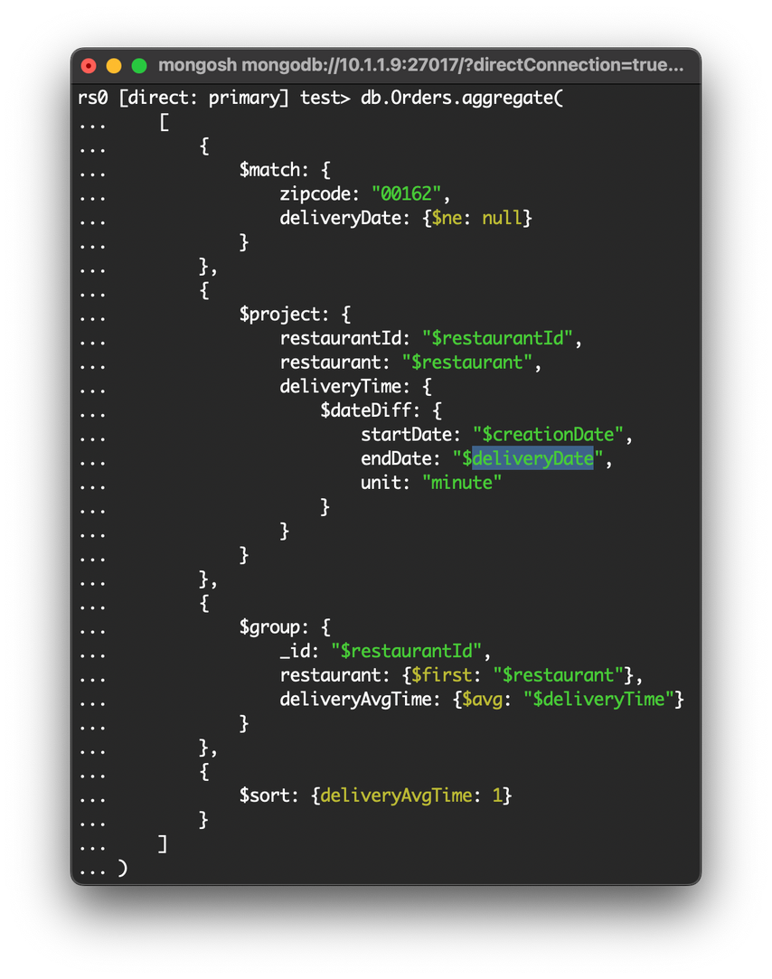
MongoDB Aggregations
Best Dish of the Day
Dish Mode
Faster Restaurant by Zipcode

Slide 15


Indexes
The Usual
Without index:
Execution Time: 896
Keys Examined: 602701
Docs Examined: 602701
With index on User:
Execution Time: 10
Keys Examined: 19
Docs Examined: 19
With index on User and RID:
Execution Time: 6
Keys Examined: 5
Docs Examined: 5
Most Busy Hours
Without index:
Execution Time: 946
Keys Examined: 602701
Docs Examined: 602701
With index on RID and cDATE:
Execution Time: 0
Keys Examined: 20
Docs Examined: 20
Faster Restaurant by Zipcode
Without index:
Execution Time: 1158
Keys Examined: 602701
Docs Examined: 602701
With index on Zipcode:
Execution Time: 27
Keys Examined: 1729
Docs Examined: 1729

Slide 16






Design For Neo4J
FOLLOW
Restaurant
User
RATED
name
id
zipcode
username
mark
comment

Slide 17


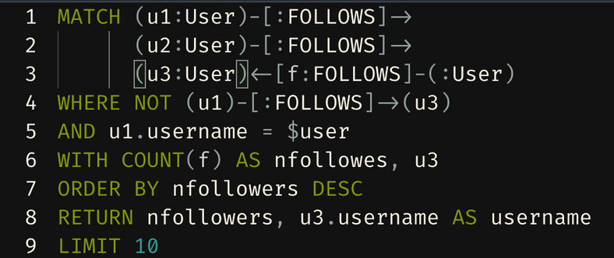


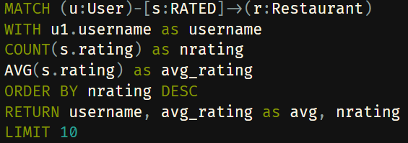
Neo4J Query
Recommend User by Follower
This Query in Neo4j it's useful for made-up a recommendation system that suggest new friends to follow based on the following of friends.
Most Active Users
This Query in Neo4j it's useful to the Administrator for know the most active users, i.e the users who made the greater number of rates and comments

Slide 18
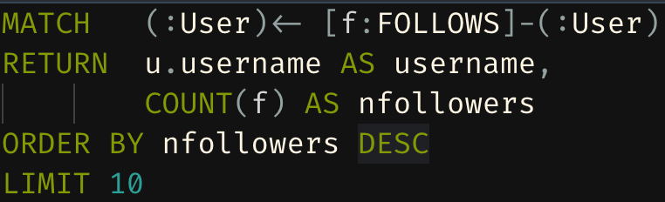

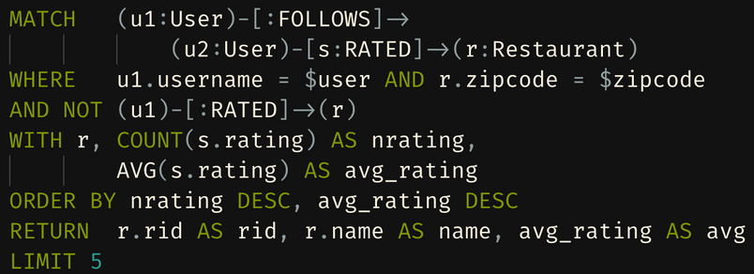
Neo4J Query
Influencer
This Query in Neo4j it's useful for made-up a recommendation system that suggest supernode.
Recommend Restaurant
This Query in Neo4j it's useful for made-up a recommendation system that suggest a restaurant based on what the followers of the user had vote

Slide 19

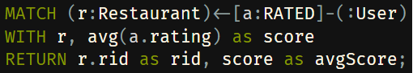
Neo4J And MongoDB
Update Redundant Average Rate in MongoDB
We choose to use a redundant attribute in the Restaurant collection in MongoDB to avoid double query during the research of the restaurants. This query of Neo4J it's useful to maintain the consistency of the system. This is made just by the Admin, because it's an expensive operation.

Slide 20




Sharding
On our case, the most appropriate way to shard our database is to partition on zip codes. The majority of operations are made by zip code, so any related read-write operation or any aggregation can be made directly on the same server without wasting time searching in which server the information i need is.

Slide 21



Architecture
JSP
Mongo Java Driver
Java Servlet
Neo4J Java Driver
MongoDB
Neo4J

Slide 22



